Slide 1
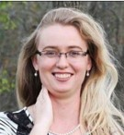
A Year of
Kids’ STEM Workshops
on a Budget!
Emily Zorea
Youth Services Librarian
Brewer Public Library

Slide 2
A thank you to our program’s biggest supporters…
Martha Bauer- Brewer Public Library Director
Marge Loch-Wouters-SWLS Youth Services Consultant
Friends of Brewer Public Library
Organizations who have awarded our program grants.

Slide 3
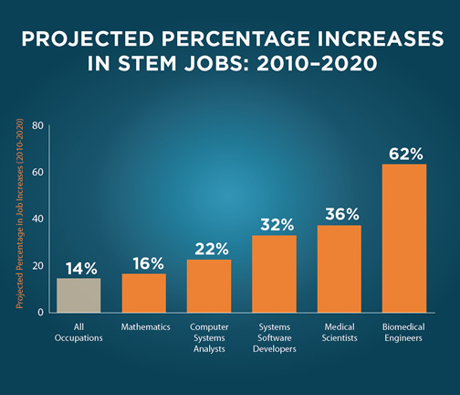
STEM and Our Future
Notes:
STEM and Our Future:
Definition for STEM
Many of the challenges of the 21st century are rooted in STEM fields.A Knowledge of STEM is essential for a well-informed citizenry

Slide 4
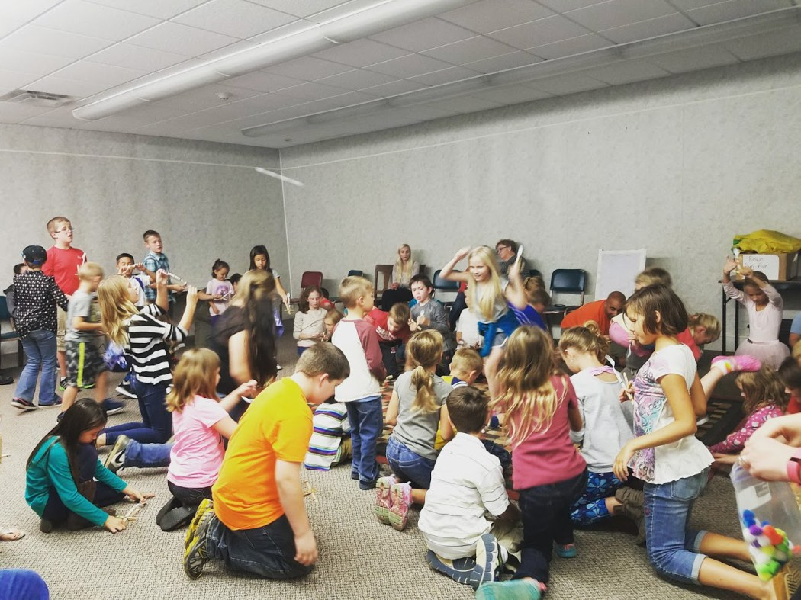
STEM as a Community Education
Notes:
STEM as a Community Education:
-When I began to plan out a long-term plan for our STEM Workshops, I was learning that research backed up the model of what I had in mind, which was to use the public library as a place where our community, youth, parents, siblings, and strangers, could come together to explore using informal experiences.
Youth only spend 5% of their lives in the classroom.
Most learning, most science, is learned outside of formal education.
All learning positively influences the classroom experience.
Research shows that when families, schools, and community work together to support learning, students perform better academically.
In fact, the greatest factor that affects youth’s immediate and later success is the family’s attitude that learning is a positive experience.
Libraries offer a physical place to bring our community together to support the learning of youth while maintaining a family holistic program.

Slide 5
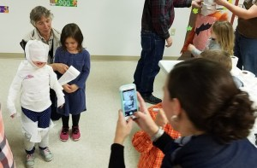
A Year of Kids’ STEM Workshops
Notes:
A Year of Kids’ STEM Workshops
- Began out of a library system grant inspiration-LSTA.
Wanted to have a forum to use materials and not let them “sit on the shelf”.
Began in September-still running
Offered on the 2nd and 4th Monday of every month.
This was a night when few other family community programs were taking place.
Started at 6pm, and now we have added a 4pm time as well.
Will continue offering these workshops every Monday evening throughout the summer.
Budget= $0.30 a child per program, or less. A few programs using some special materials did cost more. These were purchased for us through grants.

Slide 6
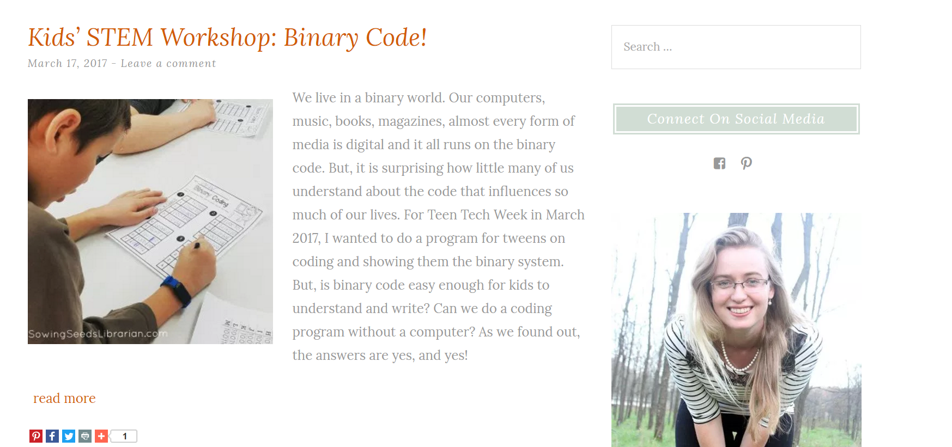
Notes:
And all the information is…
I wanted these ideas to be easily duplicated.
Blogs were my mentors, wanted to pass these ideas along.

Slide 7
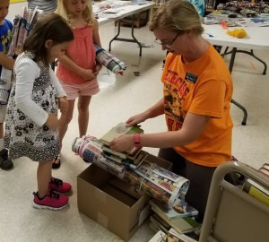
Bridge Engineering with Newspaper
Notes:
Bridge Engineering with Newspaper:
1st program
$0 to offer
Paper was donated from print shop
Showed a Prezi presentation on bridge design from the Show Me Librarian

Slide 8
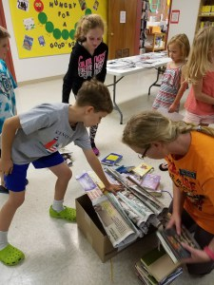
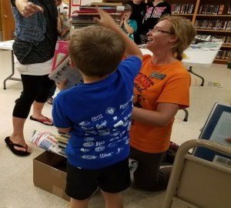

Slide 9
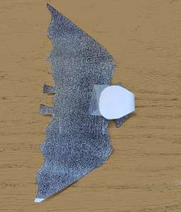
Bats in Flight
Notes:
Bats in flight
$0
All you need is the template and some paper clips, scissors and tape

Slide 10
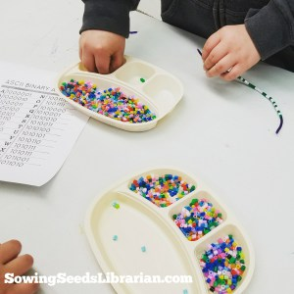
Binary Code
Notes:
Binary Code:
$0 we had all the supplies on hand.
You can order the beads on Amazon for $13 for 6,000
Need downloadable- Binary alphabet, Binary Coding Sheet, and the Binary numbers

Slide 11
Notes:
https://www.youtube.com/watch?v=s9LqqC2cVfg

Slide 12
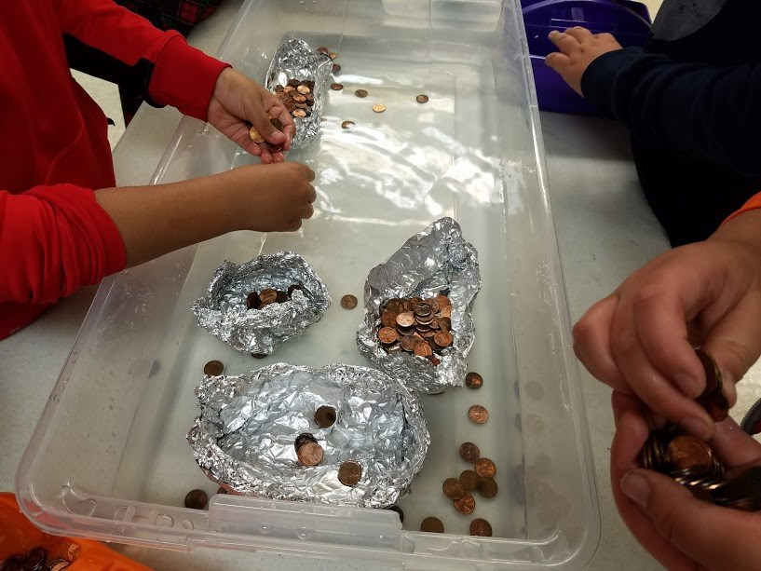
Float or Won’t-Boat Building
Notes:
Float or Won’t
Cost $15 for tin foil (2 rolls of 180 feet each roll)
Underbed storage containers $80 worth. But, we will be able to use these again.
$20 in pennies…but we will be able to continue using these again and again
Buoyancy, density, and the Archimedes' principal

Slide 13
Catapults
Notes:
Catapults
-our highest attended program
- https://www.youtube.com/watch?v=XchdUB-ZnKc

Slide 14
Notes:
Just need two tongue compressors, five popsicle sticks, rubber bands, and pom poms, and a plastic spoon
https://www.youtube.com/watch?v=XchdUB-ZnKc
https://www.youtube.com/watch?v=XchdUB-ZnKc

Slide 15
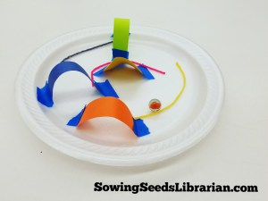
Marble Maze-Push and Pull Physics
Notes:
Marble Maze-
Cost= $0.25 per child.
Supplies: Foam plates, marbles, painter’s tape, paper scraps, Wikki Sticks

Slide 16
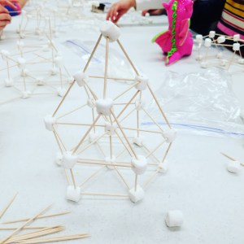
Marshmallow Igloos
Notes:
Marshmallow Igloos
$0.30 per child
Need: Marshmallows, toothpicks, paper plates to carry creations home, sandwich bags to pre-portion out how many marshmallows each child will receive.
I used 7 10 oz. bags of mini marshmallows 5 boxes of 500 count toothpicks Sandwich bags Paper plates to build on (and carry their creations home!)
I was able to divide all these supplies into 55 bags to serve 55 children.

Slide 17
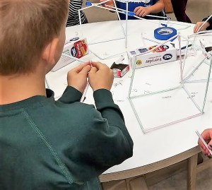
Straw Towers
Notes:
Straw Towers
-Cost $0.30 per child.
-Need: straws and paper clips. You will need way more paper clips than you think!
Straws are $1 a box at Walmart for 100 count. Plan on one box serving 3 children.
Paper clips: 1 box will also serve 2-3 children.

Slide 18
Toilet Paper Mummies
Notes:
Toilet Paper Mummies
About $0.25 per child
Math estimation

Slide 19
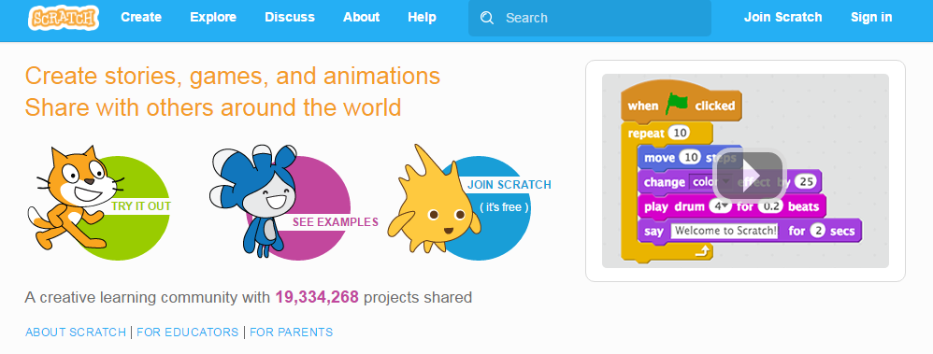
Coding with Scratch
Notes:
Coding with Scratch
https://scratch.mit.edu/
Possibly Play video

Slide 20
STEM Planning Resources
StarNet-Science-Technology Resources for Libraries
Show Me Librarian Blog
Pinterest
Notes:
http://clearinghouse.starnetlibraries.org/index.php

Slide 21
Grants:
Notes:
Grants:
-Friends Group
Talk with your director about what bills your library pays. Look up every one of those companies. Many of them have foundations. Since your library is a patron of their business, you are probably very likely to be accepted for any grant that you apply for, as long as it is within the scope of their foundation.
For example, I realized our library pays monthly bills to We Energies….
Talk to your local paper or radio station. Ask if you could have a news segment detailing any grants that you have won
Pay attention in your community if you hear of another program receiving grants. Ask questions.
Local funding can be your best bet because you will have built a reputation and a face.
Cultivate relationships outside of the library in your personal life. Community First Bank.
Send thank you notes immediately after being awarded. Try do send one again several months later with an update and pictures on how you used that money.
Keep an excel file of all grants, and when you spend down grant money.
Keep a record of all grants you apply for, with the name and address of the organization and any names of people you talk to. Hang this somewhere where you will see it. It makes it so much easier to write thank you notes during the year.
Grants give way to more grants.

Slide 22
STEM in your Community
What do Kids’ STEM Workshops look like in your community?
Plan and Schedule.
Identify supporters.
Identify needed resources.

Slide 23
Let’s keep good ideas circulating!
Emily Zorea
ezorea@swls.org
SowingSeedsLibrarian.com

Slide 24
Thank you!

